Slide 1

Personal Health Management
Database Management and Database Design
Team-3
Swati Bhojwani
Sahithi Sarabu
Geetha Vardhani Sreepada
Yeshaswini Gupta
Maheswari Kanti

Slide 2
Database Purpose
Track patient's health specific information like Observations, Appointments and Activity
Alert the health supporters in cases of criticality
Reduce the chances of severity in the already existing medical conditions by reporting the abnormalities

Slide 3
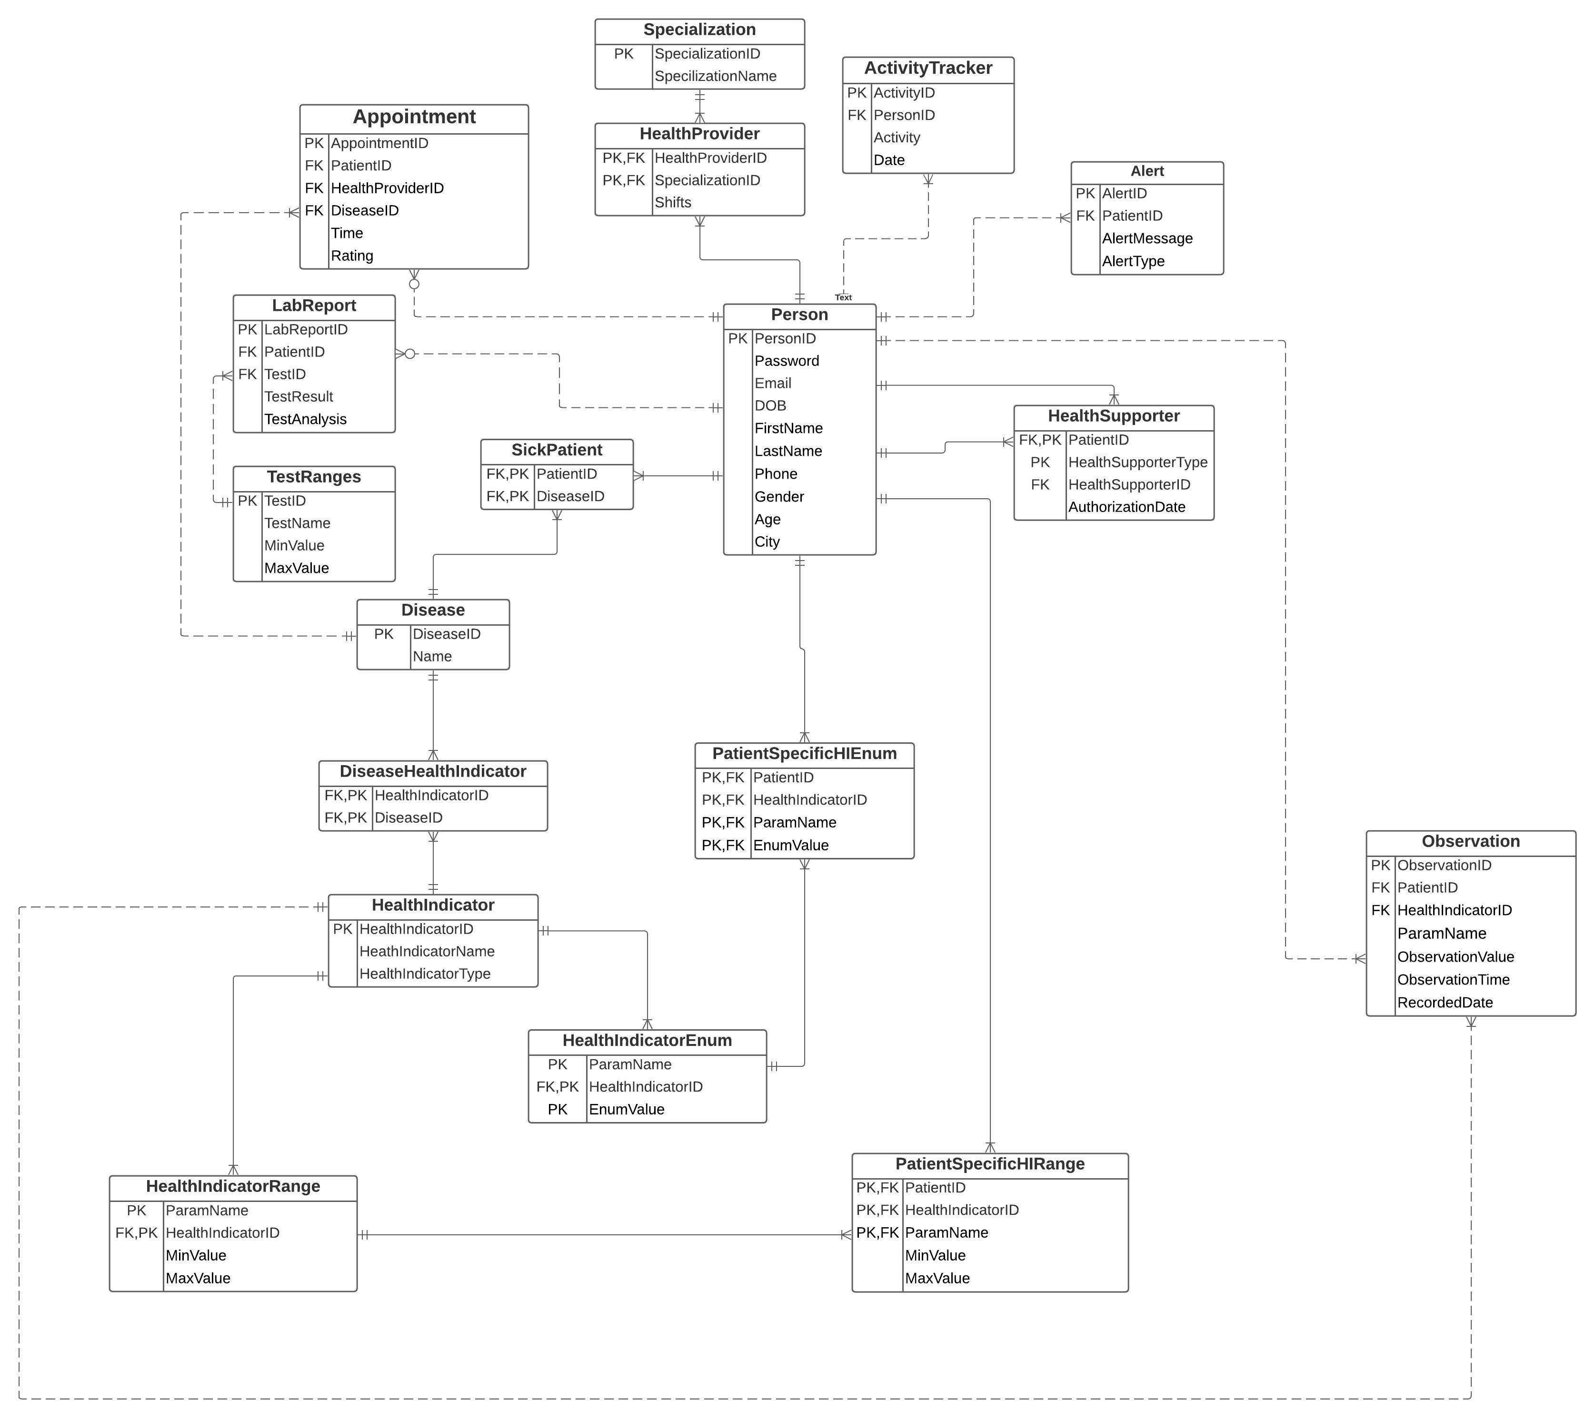
Entity Relationship Diagram

Slide 4
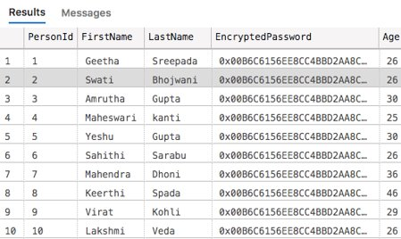
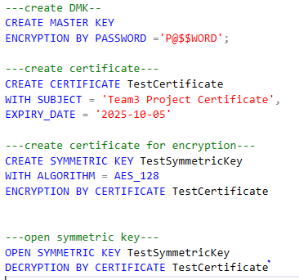
Column Data Encryption

Slide 5
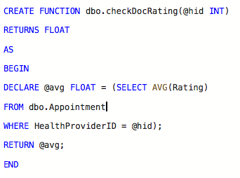

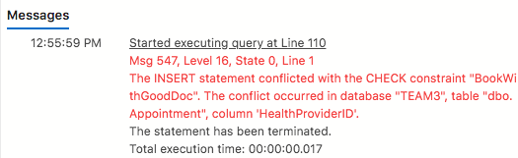
Table-level CHECK Constraint based on Function

Slide 6
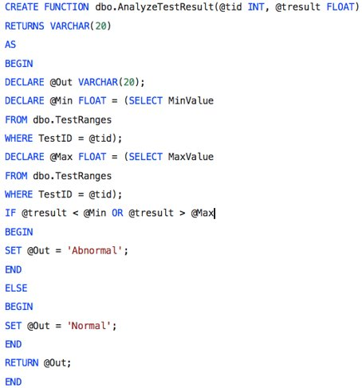

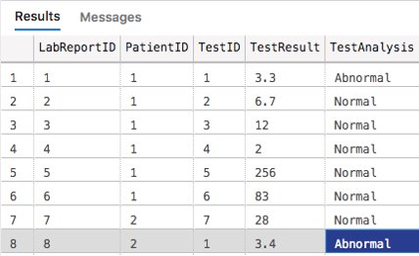
Computed Column based on Function

Slide 7
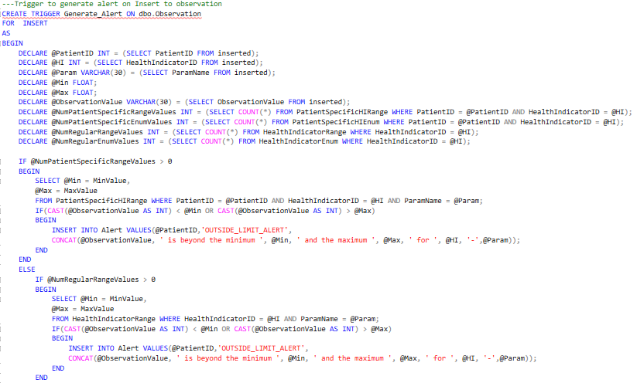

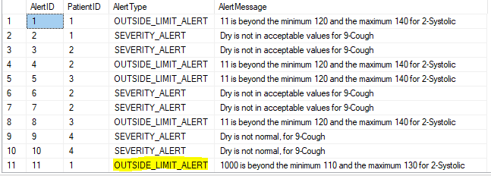
Trigger to generate Alerts

Slide 8
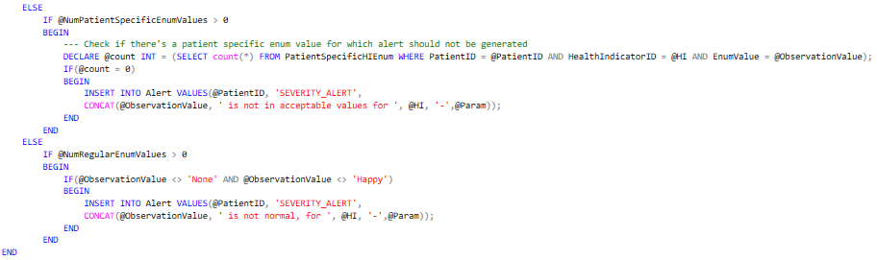
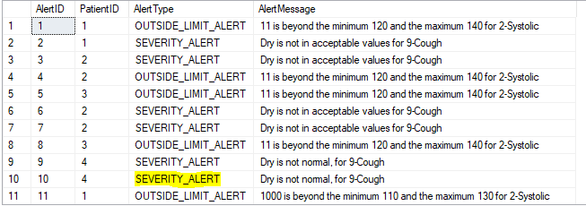

Trigger to generate Alerts (Cont'd)

Slide 9
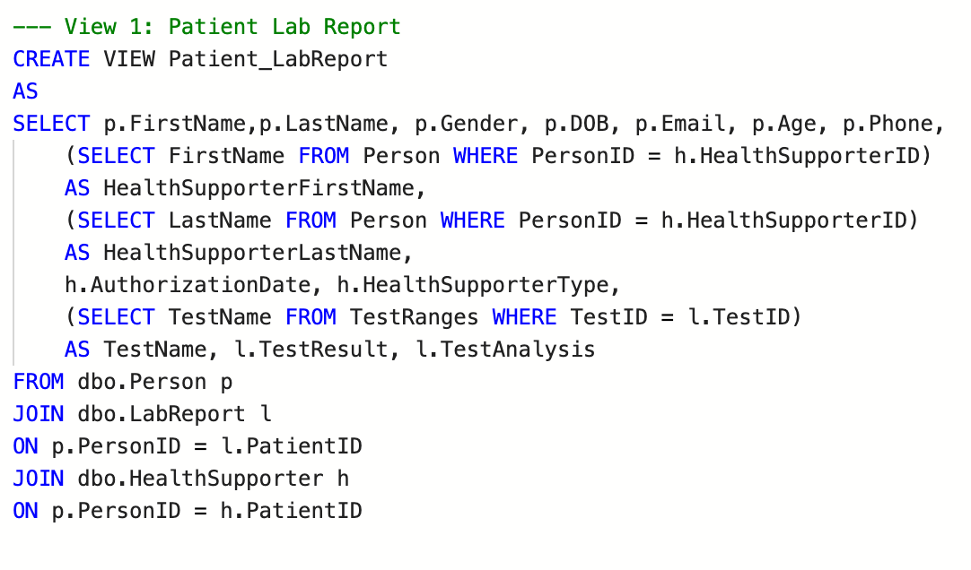
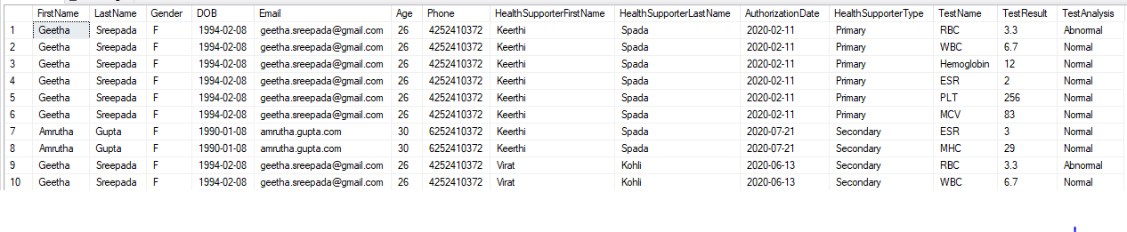
View Detailing Patient's Details

Slide 10
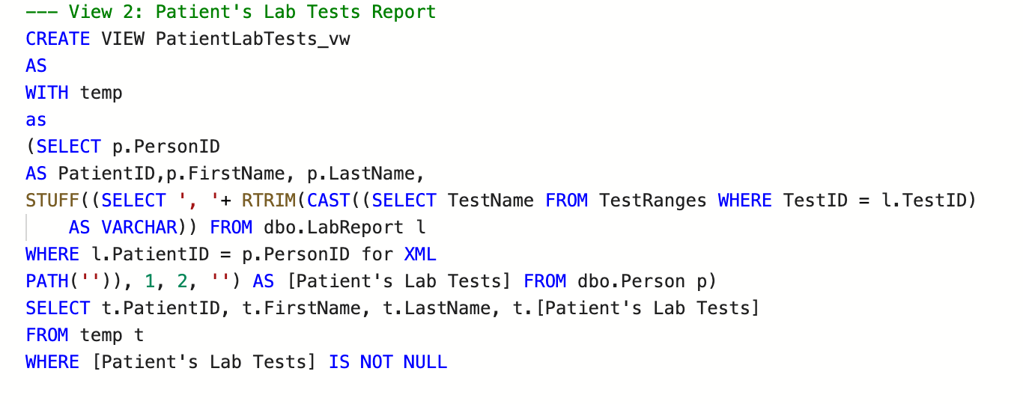
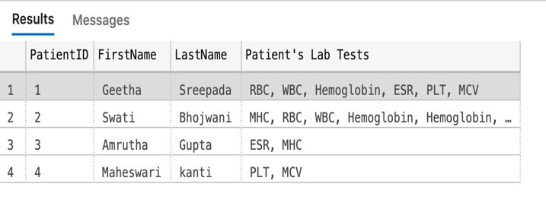
View Detailing Tests Taken by Patients

Slide 11
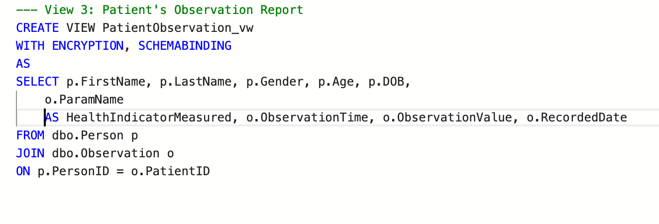
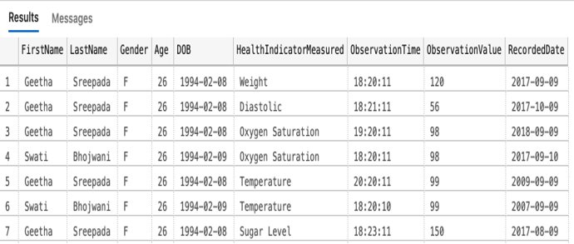
View Showing Patient's Observations

Slide 12
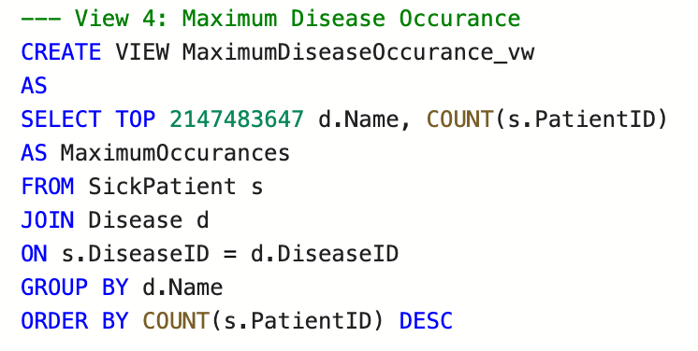
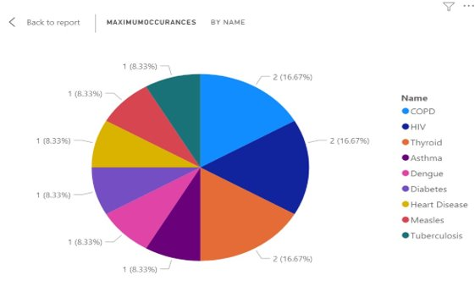
Most Common Diseases Reported

Slide 13
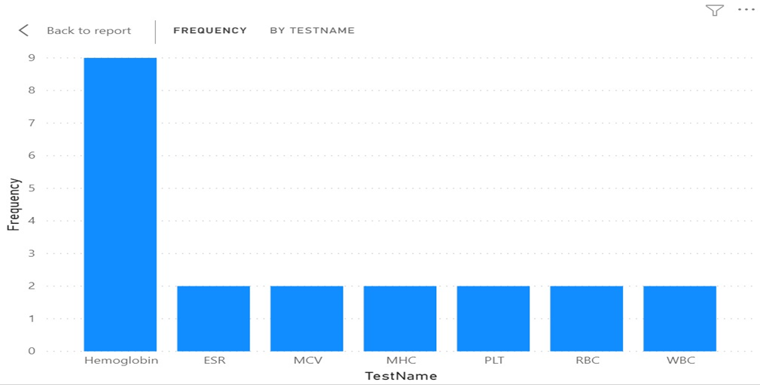
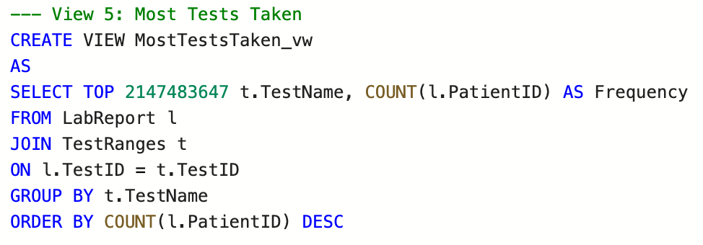
Frequent Tests Taken

Slide 14
Conclusion
We presented a database that records patient's health to assist them track and manage health status information.
Patients and Health Supporters can keep track of patient's observation values about certain health indicators and daily activities.
By analyzing data using SQL queries and presenting in Power BI, we can help patients with recording and monitoring specific health indicators, raise alerts by notifying health supporter.

Slide 15


Thank You!!!
Any Questions??

